Slide 1

Department of Computer Science and Engineering
Uttara University
AUTONOMOUS BORDER SURVEILLANCE
SYSTEM
Student 1 ID: 2223081070
Student 1 Name: Mahmudul Hasan Khan
Student 2 ID: 2223081071
Student 2 Name: Arif Khan
Supervisor
SHEBIKA RANI
Lecturer
Dept of CSE
Uttara University

Slide 2

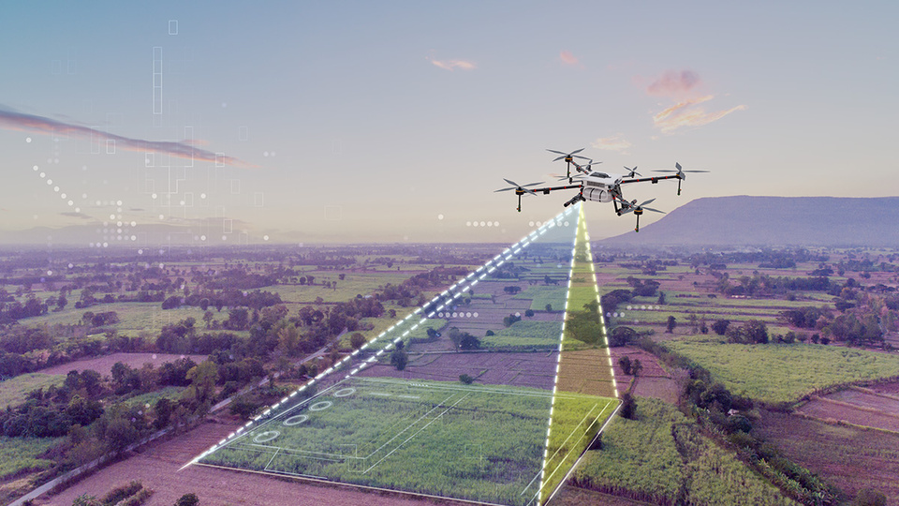
Department of Computer Science and Engineering
Uttara University
INTRODUCTION
Border surveillance is a critical requirement for national security and defense systems. Traditional border monitoring methods depend largely on human patrols and fixed surveillance infrastructure, which are costly, inefficient, and vulnerable to human error.
This research proposes an Autonomous Border Surveillance System that uses heuristic optimization and graph-based algorithms to enable intelligent, energy-efficient, and adaptive drone navigation in border areas.
Figure 1
Source: www.csm.tech

Slide 3




Department of Computer Science and Engineering
Uttara University
BACKGROUND STUDY
Autonomous Drone-Based Border Surveillance Using Real-Time Object Detection with Yolo
Energy-Efficient Meta-Heuristic Path Planning (Applied Sciences 2024)
Energy-aware Multi-UAV Coverage Mission Planning (Feb 2024)
  Predefined waypoints
  Fixed return path
  Real-time threat detection
  Path optimality
  Energy consumption
  Convergence speed
  Energy estimate matches 97% with real flight data
  Proposed method energy-wise competitive

Slide 4





Department of Computer Science and Engineering
Uttara University
PROBLEM STATEMENTS
Limited Monitoring Capability
Energy Constraints
Lack of Adaptability
Many systems fail to calculate the point of no return, causing drones to run out of battery before reaching the base station.
Real-time visualization and mission monitoring tools are often insufficient.
they cannot change their path when a new no-fly zone or threat appears suddenly.

Slide 5

Department of Computer Science and Engineering
Uttara University
AIM OF THE RESEARCH
The primary aim of this research is to design and simulate an autonomous drone-based border surveillance system that ensures efficient area coverage, energy-aware navigation, and mission safety using heuristic optimization techniques.
intelligently plan
Save energy
Safely complete
Area coverage

Slide 6





Department of Computer Science and Engineering
Uttara University
OBJECTIVES
The main objectives of this research are:
To model drone path planning as an energy optimization problem
To design an energy-aware cost function for navigation
To apply heuristic optimization algorithms for efficient path planning
To reduce battery consumption during surveillance missions
To compare the proposed method with traditional path planning approaches

Slide 7
Department of Computer Science and Engineering
Uttara University
REQUIREMENTS
Software Requirements
Functional Requirements
Hardware Requirements
Non-Functional Requirements
Data Requirements
  Programming Language: Python / Java
  Google Maps API or equivalent mapping tools
  Simulation and visualization libraries
  Autonomous coverage path planning
  Dynamic obstacle and threat avoidance
  Battery monitoring and safe return mechanism
  Real-time visualization of drone movement and telemetry
Software Requirements
  Energy efficiency
  High reliability and safety
  Scalability and flexibility
  Real-time performance
  Personal computer or laptop
  Mobile device for simulation visualization
  Simulated border maps
  Obstacle and no-fly zone data
  Battery consumption parameters
  Programming Language: Python / Java
  Google Maps API or equivalent mapping tools
  Simulation and visualization libraries

Slide 8



Department of Computer Science and Engineering
Uttara University
SCOPE OF THE PROJECT
Boundary
The research is limited to simulation-based implementation and does not include real drone deployment
Technology
  Heuristic optimization
  graph-based algorithms
  map visualization
Data Availability
Functionality
Autonomous surveillance, dynamic routing, energy-aware navigation
User-defined and simulated border environments

Slide 9
GANTT CHART
Time line
TASKS
MONTH -1
MONTH -2
MONTH -3
MONTH -4
MONTH -5
MONTH -6
MONTH -7
Literature Review and Problem Analysis
System Design and Architecture
Algorithm Implementation
Simulation and Visualization Development
Testing and Performance Evaluation
Documentation and Thesis Writing

Slide 10

Department of Computer Science and Engineering
Uttara University
Do you have Any Questions ?

